Slide 1


H1B Case Status Prediction Model – Group 7
Arjun Rao
Kashyap Bhuva
Varun Eranki
Vishaal Prabhakar
1

Slide 2
Agenda
Problem Definition & Objective
Dataset Description
Data Preprocessing & Feature Engineering
Exploratory Data Analysis
Feature Selection
Model Deployment
Model Evaluation
Interfacing
Conclusion
Challenges Faced

Slide 3
Problem Definition & Objective
The objective of this project is to predict the case status of an H1B petition and provide insights and recommendations to reduce the chances of rejection.
To implement a machine learning model that will be useful for employers seeking foreign talent in order to make their case stronger and avoid denials.
The insights from this project would also enable foreign nationals to target the right companies and locations to increase the chances of H1B acceptance.

Slide 4

Dataset Description
H1B Visa petitions whose decisions were made in the FY 2018.
The dataset consists of 6,54,348 rows and 52 columns.
The target variable is case status which consists of 4 distinct values namely Certified, Certified-Withdrawn, Denied and Withdrawn. Since our focus is on denials events, we are considering other three categories as non-events.
There are various employer as well as employee characteristics variables available in the dataset. Our dataset is highly imbalanced since we have 98.7% of the petitions approved or withdrawn and only 1.3% rejected.
Source: https://www.uscis.gov/tools/reports-studies/h-1b-employer-data-hub-files

Slide 5


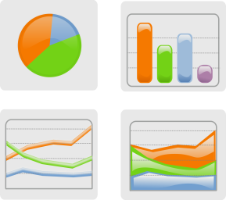
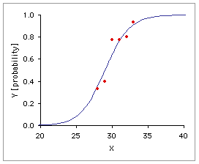
Machine Learning Methodology:
INPUT DATA
Eg. Customer, Loan & Rate Movement Data
DATA CLEANING
Treating Outliers, Missing values, Binning
EXPLORATORY
DATA ANALYSIS
Understanding data and creating variables and groups of variables
MODEL TRAINING
Preparing Data to be used to build Predictive model
MODEL TESTING AND RECALIBARATION
Preparing Data to be used to build Predictive model

Slide 6
Feature Engineering- Modifying & Creating Features
PREVAILING_WAGE | PW_UNIT_OF_PAY
92,331 | Year
80,579 | Year
88,317 | Year
104,790 | Year
109,325 | Year
82,638 | Year
69,701 | Year
65,707 | Year
31 | Hour
65,999 | Year
81,780 | Year
50,700 | Year
18 | Hour
24 | Hour
67,879 | Year
PREVAILING_WAGE | PW_UNIT_OF_PAY
92,331.00 | Year
80,579.00 | Year
88,317.00 | Year
104,790.00 | Year
109,325.00 | Year
82,638.00 | Year
69,701.00 | Year
65,707.00 | Year
64417.6 | Year
65,999.00 | Year
81,780.00 | Year
50,700.00 | Year
37232 | Year
49254.4 | Year
67,879.00 | Year

Slide 7
Feature Engineering- Coarse & Fine Classing
Employers | Denied | Total Petitions | Denial Rate | % of Total Petitions
NTT DATA, INC. | 73 | 1338 | 5.5% | 0.2%
GOOGLE LLC | 132 | 6099 | 2.2% | 0.9%
KPMG LLP | 17 | 1103 | 1.5% | 0.2%
PAYPAL, INC. | 15 | 1029 | 1.5% | 0.2%
GOLDMAN SACHS & CO. LLC | 14 | 1002 | 1.4% | 0.2%
DELOITTE & TOUCHE LLP | 22 | 1586 | 1.4% | 0.2%
TESLA, INC. | 14 | 1077 | 1.3% | 0.2%
VMWARE, INC. | 12 | 1009 | 1.2% | 0.2%
APPLE INC. | 23 | 1964 | 1.2% | 0.3%
POPULUS GROUP LLC | 11 | 1000 | 1.1% | 0.2%
EBAY INC. | 10 | 952 | 1.1% | 0.1%
JPMORGAN CHASE & CO. | 18 | 1916 | 0.9% | 0.3%
DELOITTE CONSULTING LLP | 150 | 16140 | 0.9% | 2.5%
AMAZON WEB SERVICES, INC. | 9 | 1008 | 0.9% | 0.2%
BANK OF AMERICA N.A. | 10 | 1158 | 0.9% | 0.2%
IBM CORPORATION | 42 | 5167 | 0.8% | 0.8%
ERNST & YOUNG U.S. LLP | 56 | 6892 | 0.8% | 1.1%
FACEBOOK, INC. | 22 | 2731 | 0.8% | 0.4%
VIRTUSA CORPORATION | 10 | 1249 | 0.8% | 0.2%
V-SOFT CONSULTING GROUP, INC | 7 | 904 | 0.8% | 0.1%
AMAZON.COM SERVICES, INC. | 29 | 3894 | 0.7% | 0.6%
SALESFORCE.COM INC. | 8 | 1169 | 0.7% | 0.2%
IBM INDIA PRIVATE LIMITED | 18 | 3152 | 0.6% | 0.5%
PRICEWATERHOUSECOOPERS LLP | 6 | 1126 | 0.5% | 0.2%
COMPUNNEL SOFTWARE GROUP, INC. | 9 | 1728 | 0.5% | 0.3%
PRICEWATERHOUSECOOPERS ADVISORY SERVICES LLC | 7 | 1737 | 0.4% | 0.3%
LINKEDIN CORPORATION | 3 | 905 | 0.3% | 0.1%
PEOPLE TECH GROUP INC. | 956 | 3 | 0.3% | 0.1%
KFORCE INC. | 1604 | 5 | 0.3% | 0.2%
MASTECH DIGITAL TECHNOLOGIES, INC., A MASTECH DIGITAL, INC. COMPANY | 1024 | 3 | 0.3% | 0.2%
L&T TECHNOLOGY SERVICES LIMITED | 1445 | 4 | 0.3% | 0.2%
INTEL CORPORATION | 1127 | 3 | 0.3% | 0.2%
LARSEN & TOUBRO INFOTECH LIMITED | 3100 | 7 | 0.2% | 0.5%
UST GLOBAL INC. | 909 | 2 | 0.2% | 0.1%
CAPGEMINI AMERICA INC | 6051 | 13 | 0.2% | 0.9%
WIPRO LIMITED | 6293 | 13 | 0.2% | 1.0%
WAL-MART ASSOCIATES, INC. | 1590 | 2 | 0.1% | 0.2%
TATA CONSULTANCY SERVICES LIMITED | 14587 | 17 | 0.1% | 2.2%
RANDSTAD TECHNOLOGIES, LLC | 935 | 1 | 0.1% | 0.1%
SYNTEL INC | 3338 | 3 | 0.1% | 0.5%
HCL AMERICA, INC. | 2528 | 2 | 0.1% | 0.4%
TECH MAHINDRA (AMERICAS),INC. | 5831 | 4 | 0.1% | 0.9%
ACCENTURE LLP | 6377 | 4 | 0.1% | 1.0%
COGNIZANT TECHNOLOGY SOLUTIONS US CORP | 11085 | 1 | 0.0% | 1.7%
INFOSYS LIMITED | 11591 | 0 | 0.0% | 1.8%
MICROSOFT CORPORATION | 5552 | 0 | 0.0% | 0.8%
COGNIZANT TECHNOLOGY SOLUTIONS U.S. CORPORATION | 1988 | 0 | 0.0% | 0.3%
HEXAWARE TECHNOLOGIES, INC. | 1627 | 0 | 0.0% | 0.2%
UBER TECHNOLOGIES, INC. | 1129 | 0 | 0.0% | 0.2%
MINDTREE LIMITED | 918 | 0 | 0.0% | 0.1%
Employer Bin
Bin1
Bin2
Bin3
Bin4
Bin5
Bin6
Bin7

Slide 8
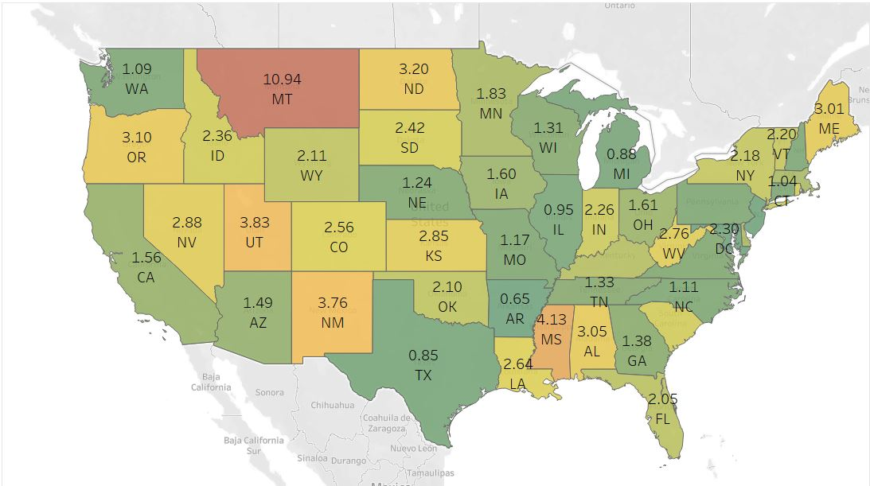
Exploratory Data Analysis: State-wise Rejection Rate (%)

Slide 9
Exploratory Data Analysis: Denial Rate for the Major Employers
Employers | Denied | Total Petitions | Denial Rate | % of Total Petitions
NTT DATA, INC. | 73 | 1,338 | 5.5% | 0.2%
GOOGLE LLC | 132 | 6,099 | 2.2% | 0.9%
KPMG LLP | 17 | 1,103 | 1.5% | 0.2%
PAYPAL, INC. | 15 | 1,029 | 1.5% | 0.2%
GOLDMAN SACHS & CO. LLC | 14 | 1,002 | 1.4% | 0.2%
DELOITTE & TOUCHE LLP | 22 | 1,586 | 1.4% | 0.2%
TESLA, INC. | 14 | 1,077 | 1.3% | 0.2%
VMWARE, INC. | 12 | 1,009 | 1.2% | 0.2%
APPLE INC. | 23 | 1,964 | 1.2% | 0.3%
POPULUS GROUP LLC | 11 | 1,000 | 1.1% | 0.2%
EBAY INC. | 10 | 952 | 1.1% | 0.1%
JPMORGAN CHASE & CO. | 18 | 1,916 | 0.9% | 0.3%
DELOITTE CONSULTING LLP | 150 | 16,140 | 0.9% | 2.5%
AMAZON WEB SERVICES, INC. | 9 | 1,008 | 0.9% | 0.2%
BANK OF AMERICA N.A. | 10 | 1,158 | 0.9% | 0.2%
IBM CORPORATION | 42 | 5,167 | 0.8% | 0.8%
ERNST & YOUNG U.S. LLP | 56 | 6,892 | 0.8% | 1.1%
FACEBOOK, INC. | 22 | 2,731 | 0.8% | 0.4%
VIRTUSA CORPORATION | 10 | 1,249 | 0.8% | 0.2%
V-SOFT CONSULTING GROUP, INC | 7 | 904 | 0.8% | 0.1%
AMAZON.COM SERVICES, INC. | 29 | 3,894 | 0.7% | 0.6%
SALESFORCE.COM INC. | 8 | 1,169 | 0.7% | 0.2%
IBM INDIA PRIVATE LIMITED | 18 | 3,152 | 0.6% | 0.5%
PRICEWATERHOUSECOOPERS LLP | 6 | 1,126 | 0.5% | 0.2%

Slide 10
Exploratory Data Analysis: Denial Rate for the Major Cities
City | Denials | Total Petitions | Denial Rate(%) | Population(%)
BOSTON | 205 | 8,254 | 2.5% | 1.3%
NEW YORK | 594 | 32,553 | 1.8% | 5.0%
MOUNTAIN VIEW | 171 | 10,095 | 1.7% | 1.5%
HOUSTON | 151 | 9,821 | 1.5% | 1.5%
SAN JOSE | 152 | 10,911 | 1.4% | 1.7%
SAN FRANCISCO | 170 | 13,333 | 1.3% | 2.0%
SEATTLE | 120 | 9,907 | 1.2% | 1.5%
PHILADELPHIA | 221 | 21,319 | 1.0% | 3.3%
DURHAM | 79 | 8,694 | 0.9% | 1.3%
SANTA CLARA | 81 | 9,119 | 0.9% | 1.4%
DALLAS | 69 | 7,986 | 0.9% | 1.2%
SECAUCUS | 58 | 7,313 | 0.8% | 1.1%
CHICAGO | 178 | 23,206 | 0.8% | 3.5%
IRVING | 68 | 9,192 | 0.7% | 1.4%
SUNNYVALE | 42 | 6,967 | 0.6% | 1.1%
EDISON | 62 | 12,502 | 0.5% | 1.9%

Slide 11
Feature Selection:
25
variables
7 variable
52 variables
Top Significant Variables | Information Value
Employer Name | 0.55
Employer City | 0.37
H1B Dependent | 0.25
NAICS Code | 0.24
Visa Duration | 0.18
Agent Attorney City | 0.18
Prevailing Wage | 0.18
SOC Code | 0.17
Unit of Pay | 0.16
Source | 0.12
Employer State | 0.11
Worksite State | 0.09
Wage Level | 0.07
Worksite County | 0.07
Agent Attorney State | 0.05
Amended Petition | 0.04
Agent Representing Employer | 0.03
Full Time Position | 0.03
Initial set of
Variables in Raw
dataset
Shortlisting 25 most
Important Variables
using the
Information Value
Final Variables

Slide 12

Evaluation Metric
The evaluation metric used was Area Under the Curve(AUC) because of the highly imbalanced dataset. The event rate was 1% . In the case of an imbalanced dataset, the accuracy will not be a good metric as the model will classify based on the majority class.

Slide 13
Hyperparameter Tuning
Scikit-learn package GridSearchCV was used for the purpose of parameter tuning.
Different combinations of hyperparameters were used to find the most optimal combination to enhance our learning model.
This can also be used for the purpose of model comparison.

Slide 14
MODEL DEPLOYMENT
LOGISTIC REGRESSION:
Logistic Regression is a classification algorithm which was used for the purpose of binary classification.
The training set used was 75% of the original dataset and the test set used was 25% of the original dataset.
The area under the curve obtained for Logistic Regression was 0.81.

Slide 15
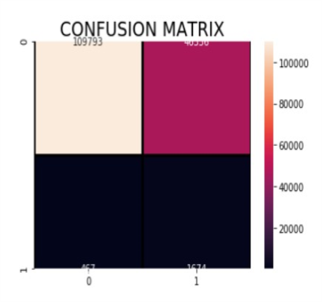
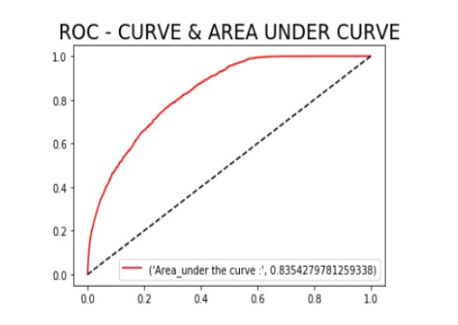
Logistic Regression Results

Slide 16
Random Forest Classifier
HOW ABOUT THE EFFECT OF IMBALANCE ON OUR CLASSIFIER ?
Random Forest Classifier is a tree-based classification algorithm which was used for the purpose of binary classification. The training set used was 75% of the original dataset and the test set used was 25% of the original dataset. The area under the curve obtained for Logistic Regression was 0.8031.

Slide 17
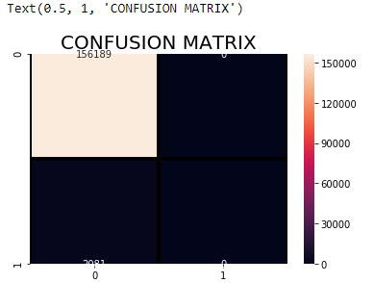
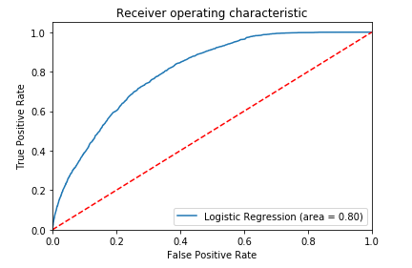
Random Forest Results

Slide 18
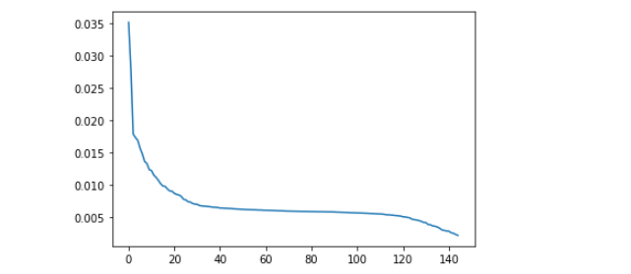
PCA
To check the variance the components were providing, we tried dimension reduction to find out which linear combination will fit our model best.
Explained Variance =0.99

Slide 19
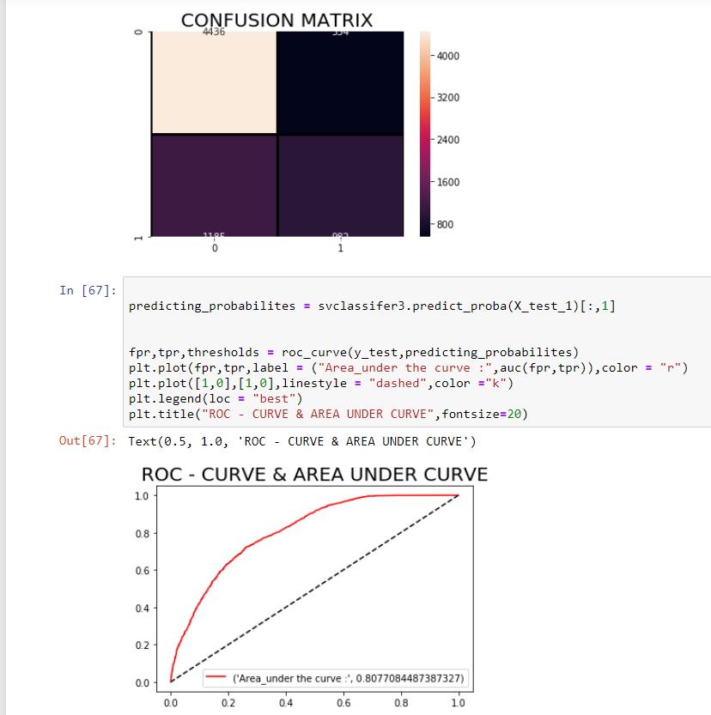
Support Vector Classifier
Performing support vector classifier, with a budget of 1.

Slide 20
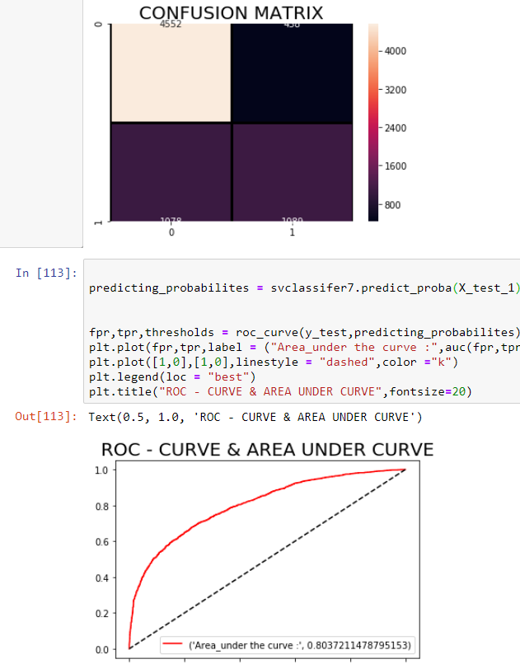
SVC
With a budget of 10 we performed the support vector classifier method to see the performance of our model

Slide 21
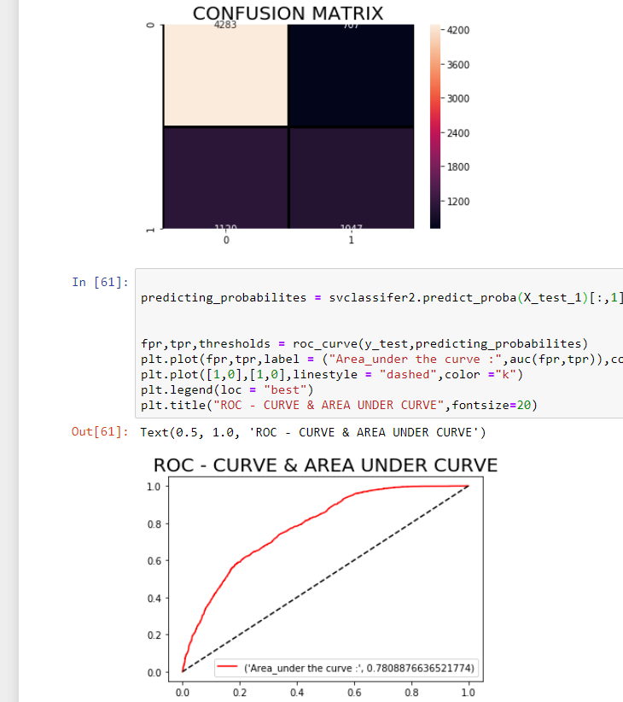
SVC
With a budget of 100 we performed the support vector classifier method to see the performance of our model

Slide 22
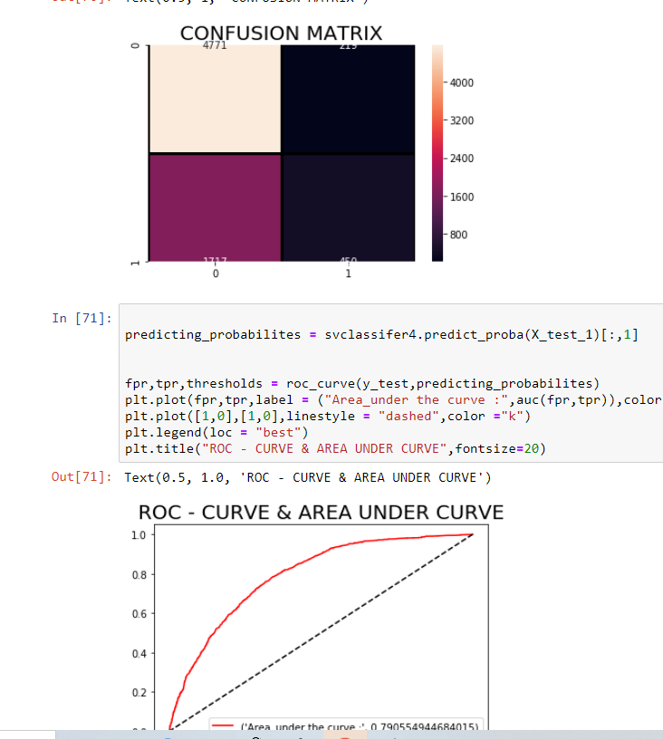
SVC
Performed support vector classifer with a linear classifier.

Slide 23
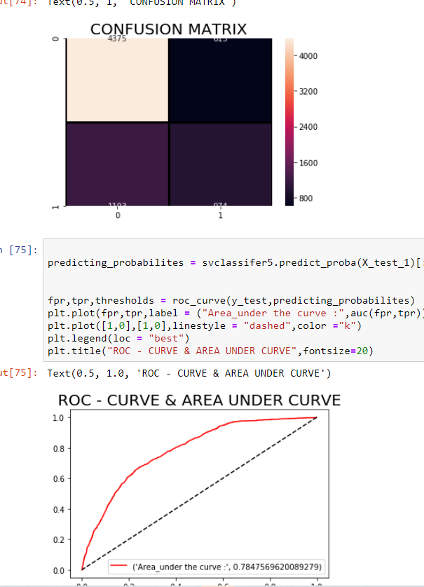
SVC
Performing support vector classifier with a polynomial kernel of degree 3

Slide 24
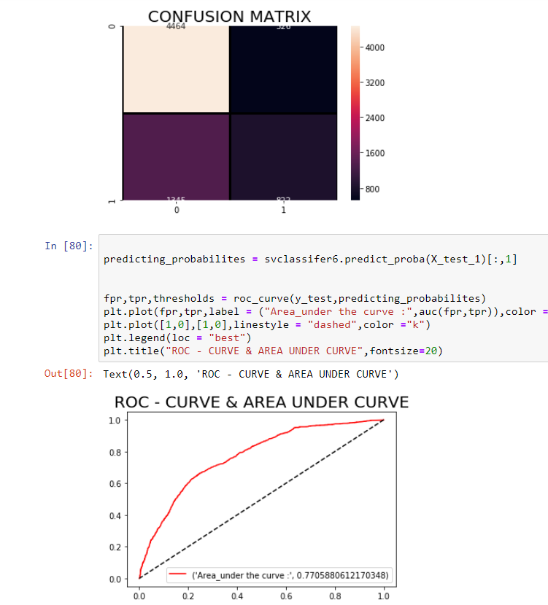
SVC
Performing support vector classifier with a polynomial kernel of degree 4

Slide 25
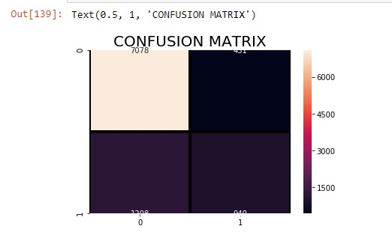
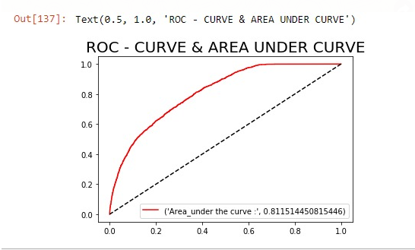
Best parameters found
'activation': ‘ReLU’
'alpha': 0.0001
'hidden_layer_sizes': (100,)
'learning_rate': 'adaptive’
'solver': 'sgd'

Slide 26
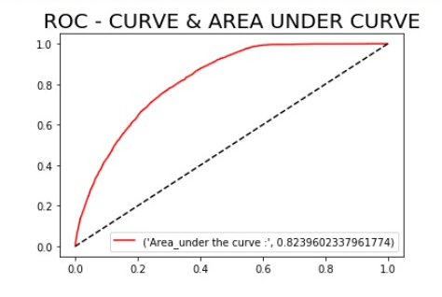
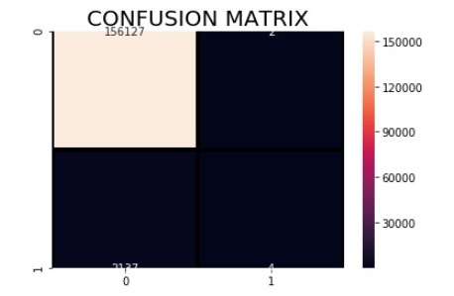
Neural Networks
Initial attempt on the neural network using all the data.
The class “DENIED” was very less when compared to the other class.

Slide 27
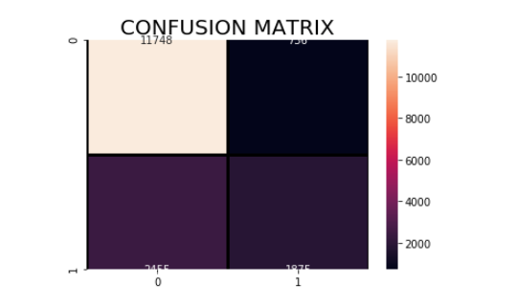
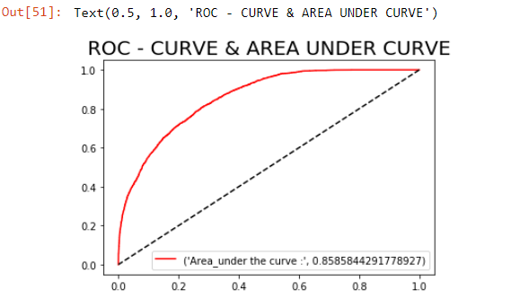
Neural Networks Oversampling
Oversampling the minority class gave us better results

Slide 28
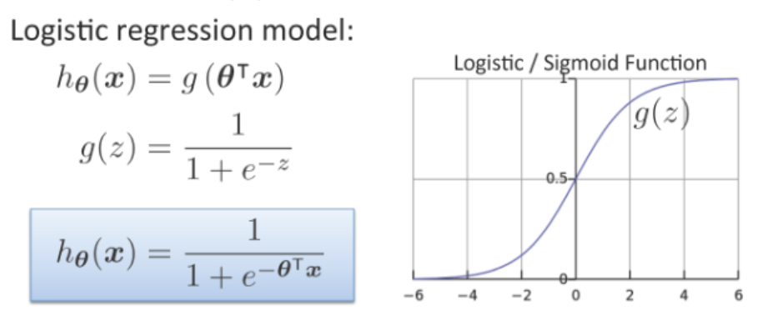
Obtaining weights vector θ
lr=LogisticRegression(solver='lbfgs')
lr.fit(trainX,trainY)
θ=lr.coef_

Slide 29
Insights
θ ∝ h_{θ}(x)
Since we cannot vary θ, we can change our input x to reduce the probability and bring it closer to 0 (Acceptance)
Higher weights mean higher probability
(closer to 1 i.e., Denial)
For a one hot encoded model, we can obtain the values of every feature which contribute more to 0 (Acceptance)
These are the values we recommend under insights to increase an applicant’s chances of Acceptance

Slide 30
Interface
A ready to deploy model for H1B applicants with a user-friendly interface
Front end with HTML
Back end with Python
Linked front end and back end with Flask

Slide 31
CHALLENGES FACED
Low Event Rate.
Cumbersome Feature Selection Process through Information Value and Weight of Evidence method.
Large scale requirement of Feature Engineering.
Large Dataset and hence large computation time.

Slide 32

Thank You ! And we hope you get your H1B petitions approved!

